Slide 1
Basic Network Analysis using R
Desmond Wallace
Scott LaCombe
October 10, 2018

Slide 2
Introduction to Networks
Growing field of Social Sciences over the last few decades
Increased availability of data and computing power
Standard Regression assumes independence of observations
Voters in District 1 not affected by Voters in District 2
Decision to mow lawn independent of neighbors mowing lawn
Network Analysis allows us to relax this assumption
Can better identify structure of the data and relationships within network

Slide 3
Who Studies Networks?
Physicists
Computer Scientists
Applied Mathematicians
Statisticians
Biologists
Ecologists
Sociologists
Political Scientists
And Everyone Else!!!

Slide 4
Assumptions
People do not operate in a vacuum
Decisions shaped by people they know
Decisions also shaped by people who know people who know you
Thus allowing for spreading of information, behavior, and outcomes

Slide 5
Source: Borgatti et al 2009, Science

Slide 6
Note: Theory matters!
Does a network approach make sense?
Is it possible for these ties to exist
What does the universe of potential ties look like
What does a tie mean?
Is your DV a network? Your IV? Both?

Slide 7
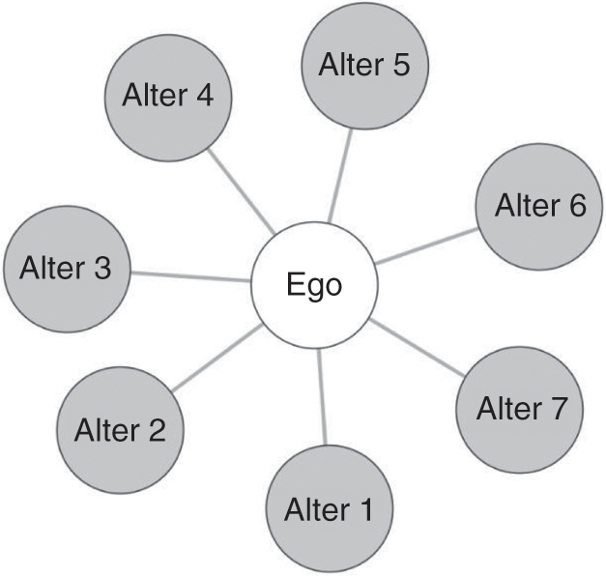
Terms
A network is a collection of nodes joined by edges
Whole network
Complete universe of cases
Sample Networks
Ego-net
Questions to ask if ego net
Who is the ego?
How many steps removed are you going from the ego?
(think 6 degrees of Kevin Bacon)
Respondent-driven sample
Some combination of the two (multiple ego nets, etc)

Slide 8
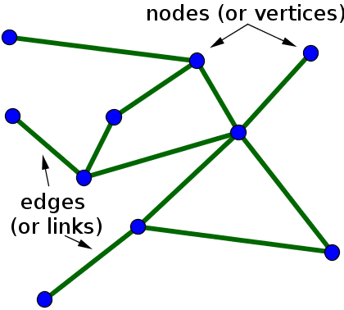
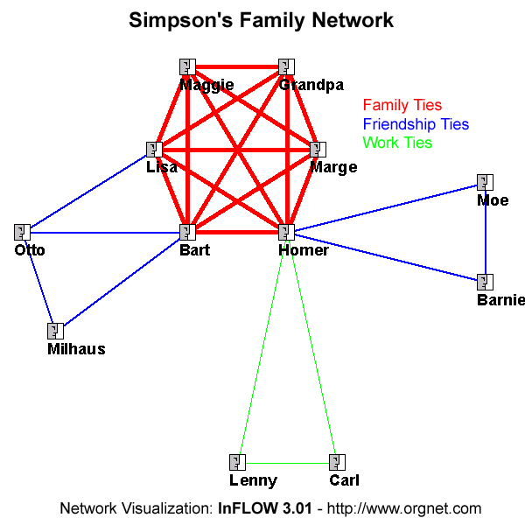
Terms
Node- unit we are examining
Could be countries, people, cities, etc.
Synonyms: Vertex, Sites, Actors
Tie- connection between two nodes
Directed or undirected?
Example directed: giving money to a person
Example undirected: friendship, conversation
Binary or Valued?
Do you only care if a tie exists?
Do you care about the nature of the tie?
Synonyms: Edge, Link, Bond

Slide 9
Examples of Networks?
Social Networks
Node – Person
Tie – Friendship, Collaboration
Information Networks
Node – Books, Web Pages
Tie – Citations, Hyperlinks
Communication Networks
Node – Email Address, Phone Number
Tie – Information Exchange
Transportation Networks
Node – Airports, Railway Stations
Tie – Non-stop Travel

Slide 10
Defining other Terms
Homophily- extent to which two nodes are similar
How close incomes are
Density- proportion of ties relative to potential ties
Out of all possible ties, what proportion are observed
Distance
Minimum number of ties needed to connect two nodes
Centrality
Importance or influence of a node (more on this later)

Slide 11
Data: Adjacency Matrix vs Edge list
Adjacency Matrix- values show connection between nodes
Often omit 0, just care about 1 if binary

Slide 12
Edgelist
2 columns- node 1, node 2
Sometimes 3rd column for weight if not binary
Missing edges not included (usually)

